Slide 1



Programming for Problem Solving

Slide 2

CHAPTER-1
Number System

Slide 3
Numbers Definition
Numbers are used in various arithmetic values applicable to carry out various arithmetic operations like addition, subtraction, multiplication, etc which are applicable in daily lives for the purpose of calculation.
The value of a number is determined by the digit, its place value in the number, and the base of the number system.
Numbers generally also known as numerals are the mathematical values used for counting, measurements, labeling, and measuring fundamental quantities.
Image source : Google

Slide 4
What is a Number System?
A Number system or numeral system is defined as an elementary system to express numbers and figures. It is the unique way of representing of numbers in arithmetic and algebraic structure.
Image source : Google

Slide 5
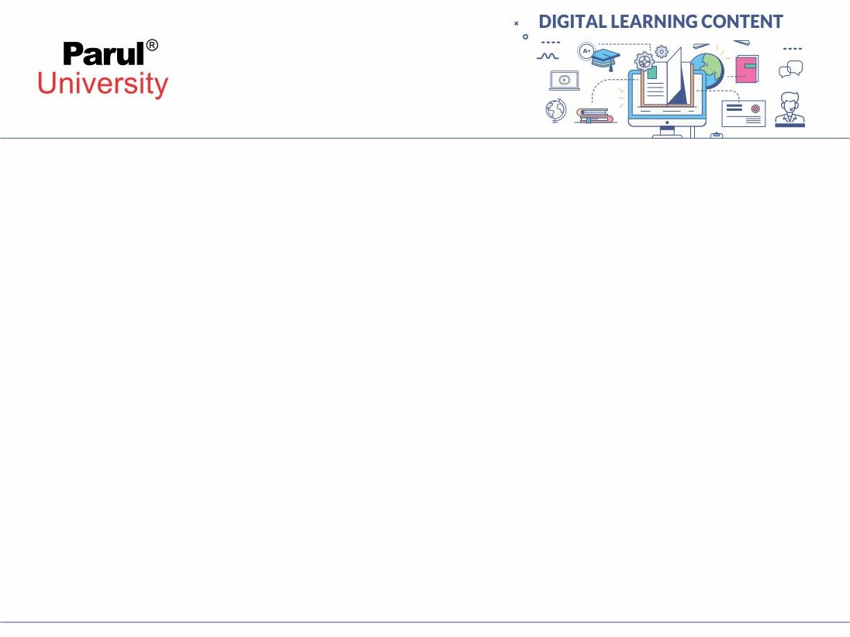
Types of Number Systems
Based on the base value and the number of allowed digits, number systems are of many types. The four common types of Number systems are:
Decimal Number System
Binary Number System
Octal Number System
Hexadecimal Number System

Slide 6
Decimal Number System
A number system with a base value of 10 is termed a Decimal number system.
It uses 10 digits i.e. 0-9 for the creation of numbers. Here, each digit in the number is at a specific place with a place value of a product of different powers of 10.
Here, the place value is termed from right to left as the first place value called units, second to the left as Tens, so on Hundreds, Thousands, etc.

Slide 7
Cont..
For example, 12265 has place values as:
(1 × 10⁴) + (2 × 10³) + (2 × 10²) + (6 × 10¹) + (5 × 10⁰)
= (1 × 10000) + (2 × 1000) + (2 × 100) + (6 × 10) + (5 × 1)
= 10000 + 2000 + 200 + 60 + 5
= 12265

Slide 8
Binary Number System
A number System with a base value of 2 is termed a Binary number system.
It uses 2 digits i.e. 0 and 1 for the creation of numbers.
The numbers formed using these two digits are termed Binary Numbers.
The binary number system is very useful in electronic devices and computer systems because it can be easily performed using just two states ON and OFF i.e. 0 and 1.

Slide 9
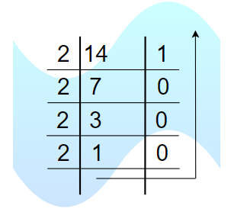
Cont…
Decimal Numbers 0-9 are represented in binary as 0, 1, 10, 11, 100, 101, 110, 111, 1000, and 1001
For example, 14 can be written as 1110, 19 can be written as 10011, and 50 can be written as 110010.
Example of 14 in the binary system
Here 14 can be written as 1110

Slide 10
Octal Number System
Octal Number System is one in which the base value is 8.
It uses 8 digits i.e. 0-7 for the creation of Octal Numbers.
Octal Numbers can be converted to Decimal values by multiplying each digit with the place value and then adding the result.
Here the place values are 80, 81, and 82. Octal Numbers are useful for the representation of UTF8 Numbers.
Example,
(81)₁₀ can be written as (121)₈
(125)₁₀ can be written as (175)₈

Slide 11
Hexadecimal Number System
A number System with a base value of 16 is known as Hexadecimal Number System.
It uses 16 digits for the creation of its numbers.
Digits from 0-9 are taken like the digits in the decimal number system but the digits from 10-15 are represented as A-F i.e. 10 is represented as A, 11 as B, 12 as C, 13 as D, 14 as E, and 15 as F.
Hexadecimal Numbers are useful for handling memory address locations.

Slide 12
Cont..

Slide 13

Quiz
7

Slide 14
What type of number system are used in UTF8?
#
Image source :
https://pixabay.com/

Slide 15
Conversion between number system
Image source : Pressman, R. S. (1987). Software engineering: A practitioner's approach. New York: McGraw-Hill.

Slide 16


www.paruluniversity.ac.in

